Slide 1
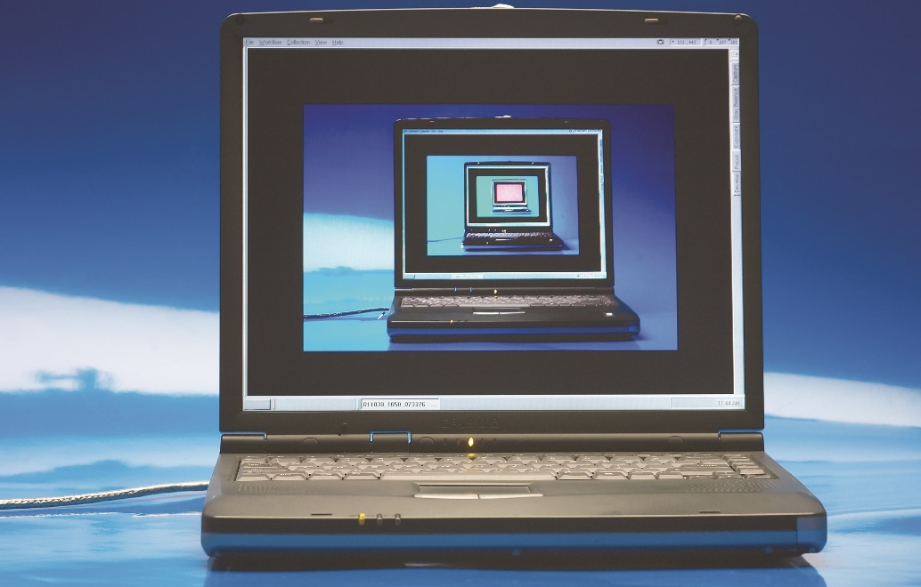
IT Essentials (CompTIA A+) Ch. 3 The Visible Computer
Chapter 3
Notes:
Charles Babbage was a mathematician in the nineteenth century, a time well before anyone thought to create electronic calculators or computers. Babbage thought of making machines that would do calculations mechanically, so the numbers would always be right. Although his ideas were ahead of his time, inventors in the mid-twentieth century picked up the concepts and created huge calculating machines that they called computers.

Slide 2
Overview
The computing process
Computing hardware
Computing software
Operating system characteristics
File structures and paths
Tech launch points

Slide 3
The Computing Process
Computer: an electronic device that can perform calculations
Typically a personal computer (PC) runs Microsoft Windows and is used for various tasks
Various types of computers
General-purpose computing devices (e.g.,Thick Client)
Specific-purpose computers (e.g., CAD, CAM)
Devices with computers inside (e.g., Automobiles, Airplanes)

Slide 4
The Computing Process
Hardware (HW), Keyboard, expansion cards, etc…
Physical components you can touch
Operating systems (OS), MAC, Windows, Linux
Controls hardware and enables user to tell the computer what to do and provides a means for human interaction. (e.g., Graphical user interface (GUI)
Applications (Apps), Programs
Allow you to do specialized tasks on a computer, basically adding abilities to the OS. (Internet Explorer, Outlook)
Notes:
4

Slide 5
The Computing Process
Basic three stages of the computing process
Input
Processing
Output
Get data into the computer (user)
Mouse, keyboard, touch screen
Tell hardware what to do (OS)
Central processing unit (CPU)
Show the results (OS)
Monitor, speakers
Notes:
Computers function through three stages: input, processing, output.
Chapter 4, “Microprocessors,” gives a lot more information on CPUs and other processing components.

Slide 6
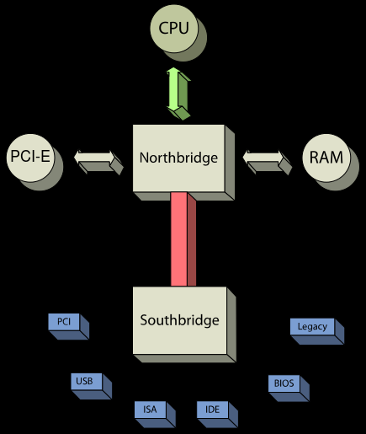
The Computing Process
Modern devices may have
additional stages
Data storage
Network connection
The computing process
applies to every device.
By understanding both the
components involved and how
they talk to each other, you can
work with any computing device.

Slide 7
The Computing Process

Slide 8
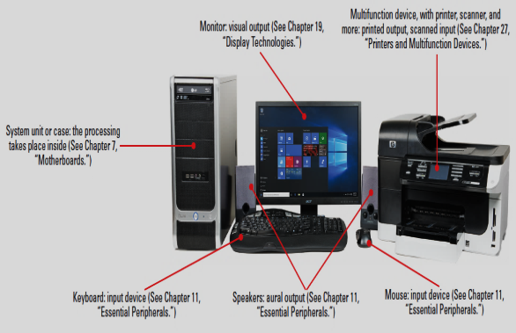
Computing Hardware
A computer system is comprised of many
components, some internal others external.
External hardware is known as a
peripheral.
Monitor
Printer
Mouse
Next Slide
Notes:
Describe the basic components here: system unit/case, monitor, mouse, speakers, printer, and keyboard.
Memorize the names of the components, connectors, and terms discussed and displayed in this section. You’ll see them in future chapters, in the real world, and on the CompTIA A+ 901 exam.

Slide 9
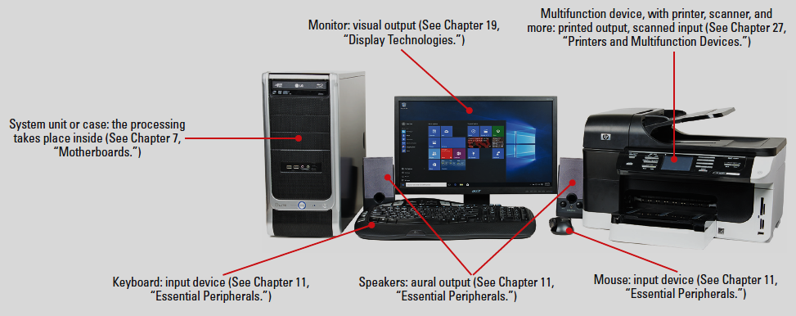
Computing Hardware
Notes:
Describe the basic components here: system unit/case, monitor, mouse, speakers, printer, and keyboard.
Memorize the names of the components, connectors, and terms discussed and displayed in this section. You’ll see them in future chapters, in the real world, and on the CompTIA A+ 901 exam.

Slide 10
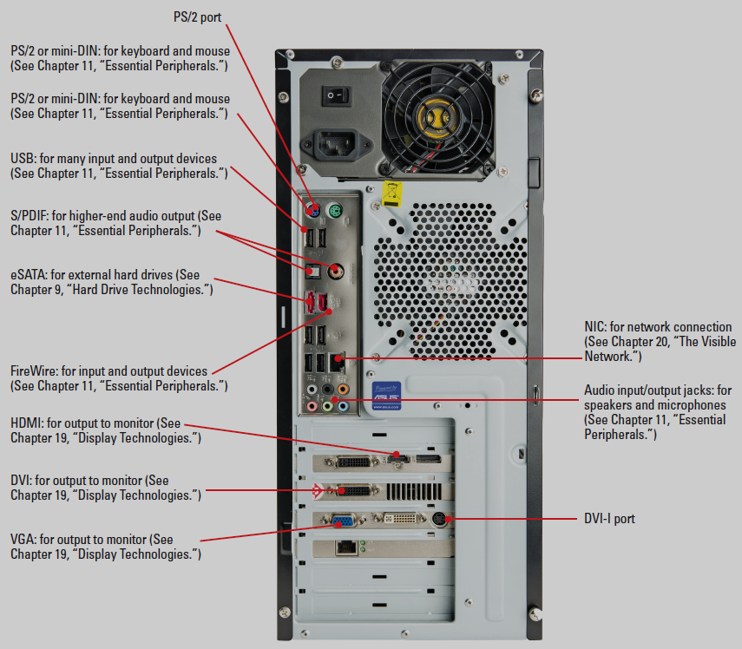
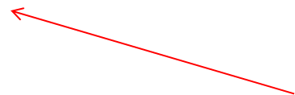
Common External Ports
Display Port
S-Video
DVI-I
Notes:
DVI is incorrectly labeled!!!!!!!!!!!!!!!!!!
10

Slide 11
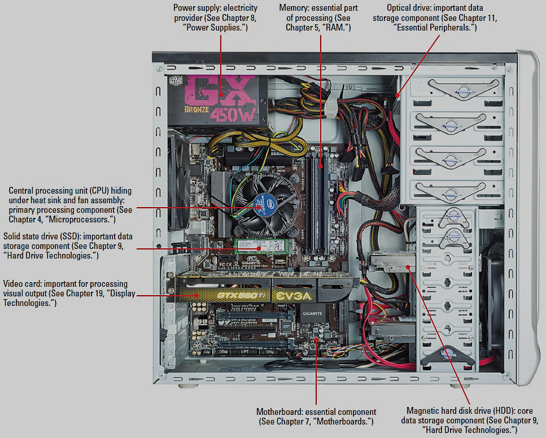
Internal Hardware

Slide 12
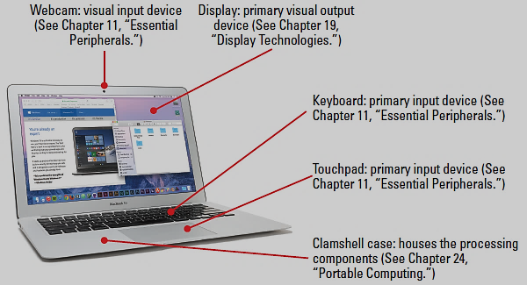
Laptop Hardware & Features
Figure 3.15 Portable computer (a MacBook Air)

Slide 13
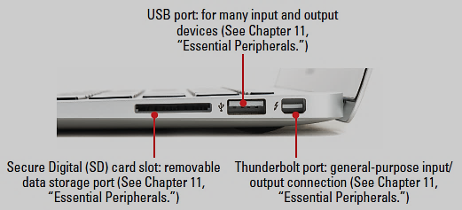
Common Laptop Ports
Figure 3.16 Ports on a portable computer

Slide 14
Computing Hardware

Slide 15
EXAM FOCUS
902 exam – mostly operating system tools
Focuses on five Microsoft operating systems
Windows Vista
Windows 7
Windows 8
Windows 8.1
Windows Phone/Mobile
Apple coverage: Mac OS X and iOS.
Linux distributions (or distros) and Google Android
Notes:
Specific Linux versions are called distributions or distros. There’s a big difference in look and feel, for example, between Ubuntu and SUSE Linux. Focus here on what you can do with every OS and you’ll be able to handle any distro easily. Google Chrome OS is used on Google’s line of portable computers (Chromebooks).
Chapter 25, “Mobile Devices,” details the three operating systems for mobile devices—iOS, Android, and Windows Phone/Mobile.

Slide 16
Understanding Software
Software (SW) is a set of instructions that allows communication between devices (hardware).
The specific SW on a device is its Firmware.
Operating Systems (OS) provide a user interface (UI) that allows people to communicate with hardware devices
Drivers interpret the instruction sets or commands sent between the OS and hardware devices.

Slide 17
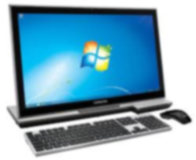
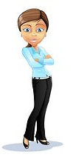
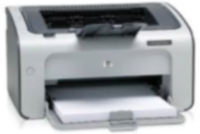
Understanding Software
Operating System (OS)
-File System(s)
-Programs
-Applications
Drivers
Drivers also interpret instructions for internal hardware, like our video, sound, etc…
If you change the OS or hardware, you’ll need to get the appropriate driver.
Firmware
Communicates with an OS via a driver.

Slide 18
Computing Software

Slide 19
Operating System Characteristics
Windows Vista/7
Desktop – background
Aero (or Aero Glass) – transparency at the edge of open applications
Start Button – click to access applications, files, tools, folders
Pinned programs – single left-click to launch
Taskbar – shows running programs
Notification area (system tray) – shows programs running in the background

Slide 20
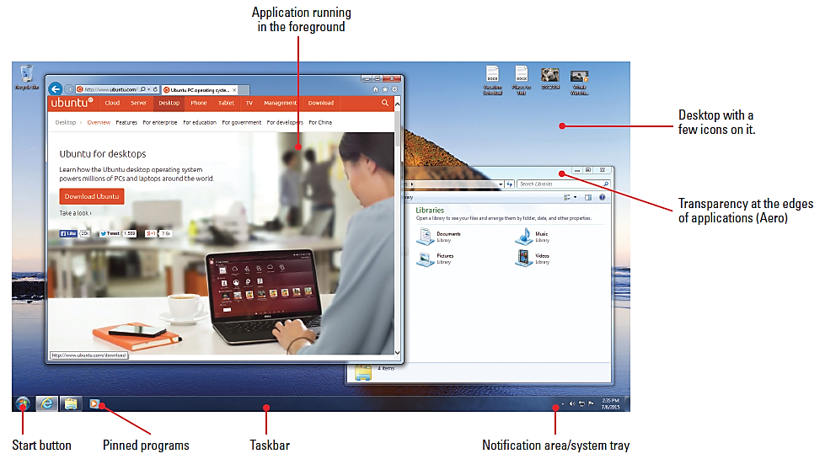
Operating System Characteristics
Windows Vista/7
Right clicking with the
mouse opens a context
Menu
Sidebar – houses one
or more Gadgets such
as the clock and calendar
Vista only
Figure 3.18 Windows 7 with applications open

Slide 21
Operating System Characteristics
Windows 8/8.1
Apps are arranged as tiles.
Pinned apps display at the bottom of the screen.
Modern User Interface (UI) is the name for the Windows 8 interface.
Start screen is the default Windows 8 interface.
The desktop screen has no Start button.
Instead, use Windows logo key on standard keyboard.
Notes:
Microsoft dropped the “Metro UI” moniker just before releasing Windows 8 due to legal concerns, replacing it with “Modern UI.” A lot of techs and IT industry pros continue to refer to the unique Windows 8/8.1 tiled interface as “Metro.”

Slide 22
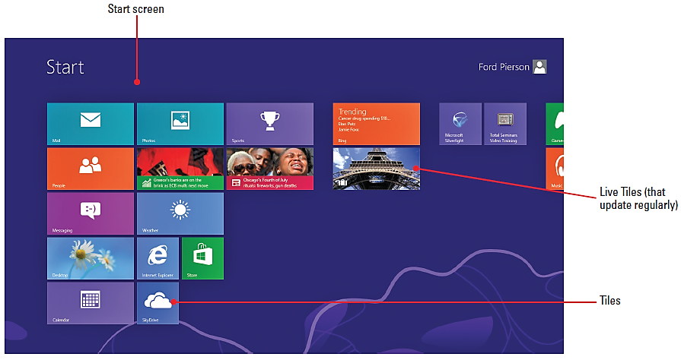
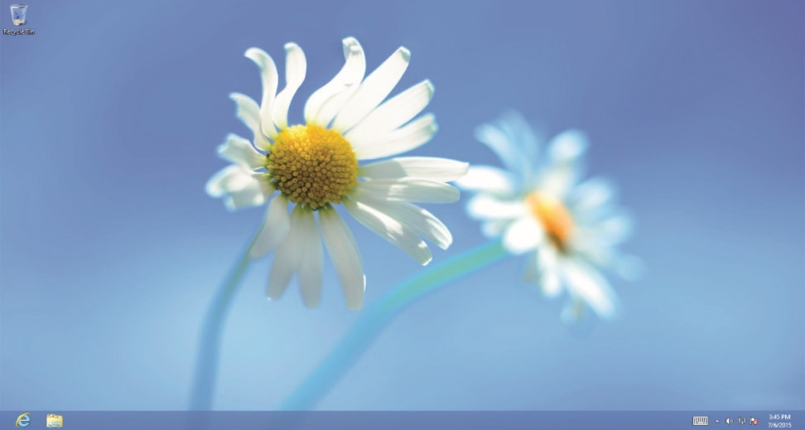
Operating System Characteristics
Windows 8/8.1
Figure 3.21 Windows 8 Start screen
Figure 3.22 Windows 8 Desktop
Figure 3.22 Windows 8 Desktop

Slide 23
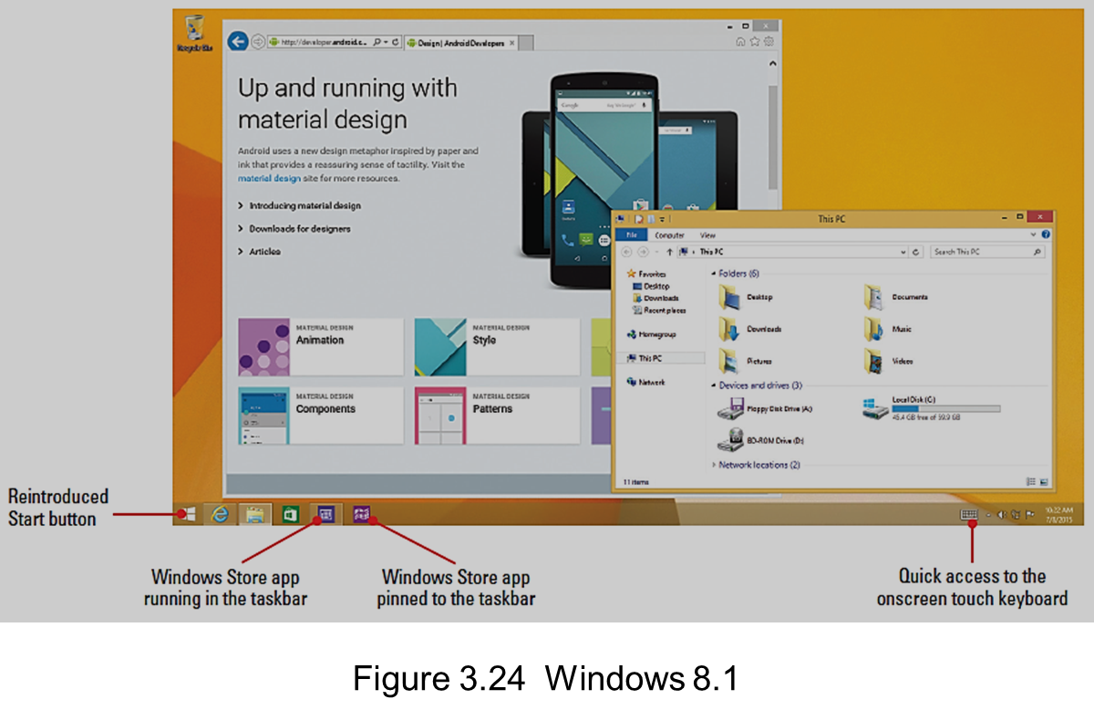
Operating System Characteristics
Windows 8/8.1
Figure 3.22 Windows 8 Desktop

Slide 24
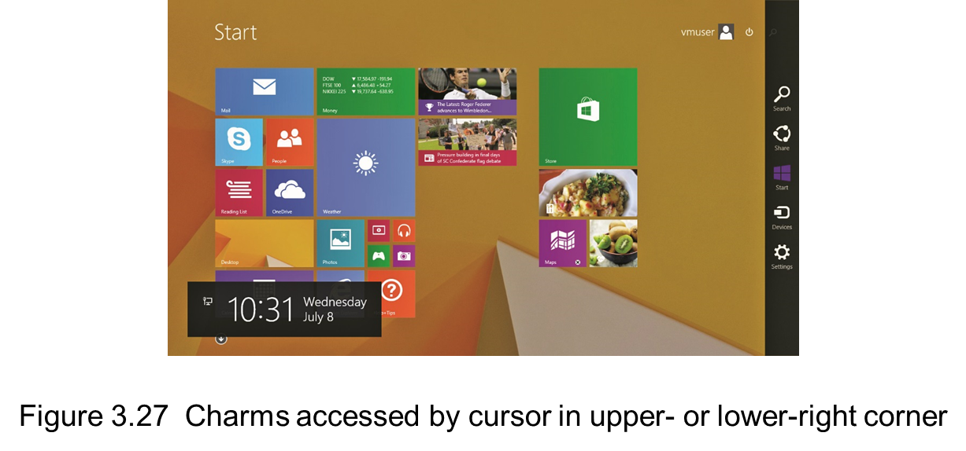
Operating System Characteristics
Windows 8/8.1 Charms bar is a location for tools called charms
Revealed by placing the cursor in the top or bottom right corner of the screen

Slide 25
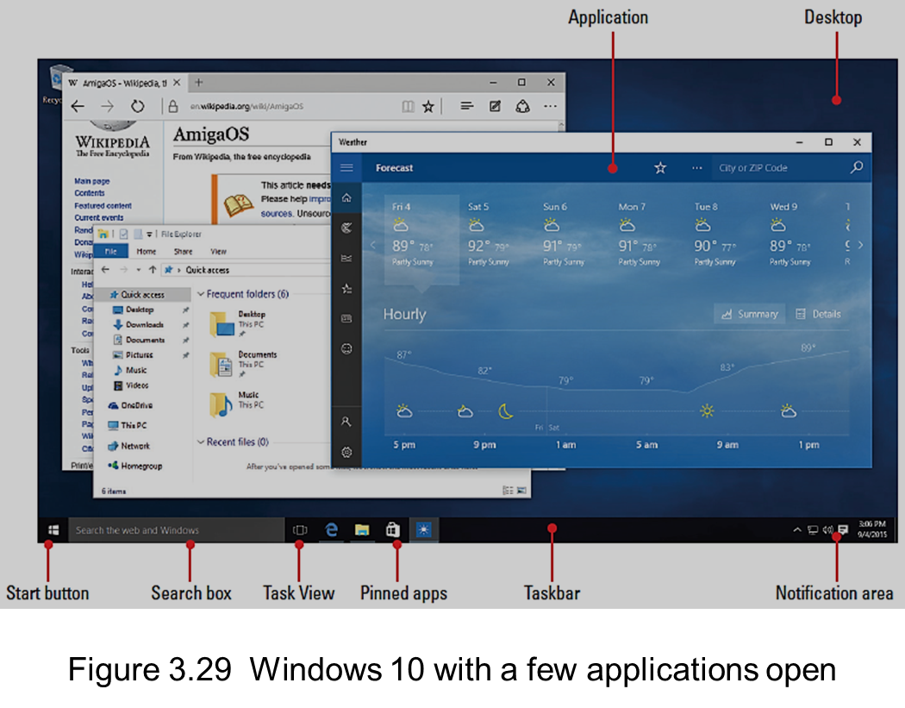
Operating System Characteristics
Windows 10 blends traditional Desktop experience with the Modern UI
Retained Start menu
Removed Charms
Bar
Create and manages
multiple Desktops for
grouping open
applications with the
Task View button
Notes:
You don’t need to memorize the Windows 10 information for the current CompTIA A+ exam. It’s included here because you need to know it to be a successful tech today.

Slide 26
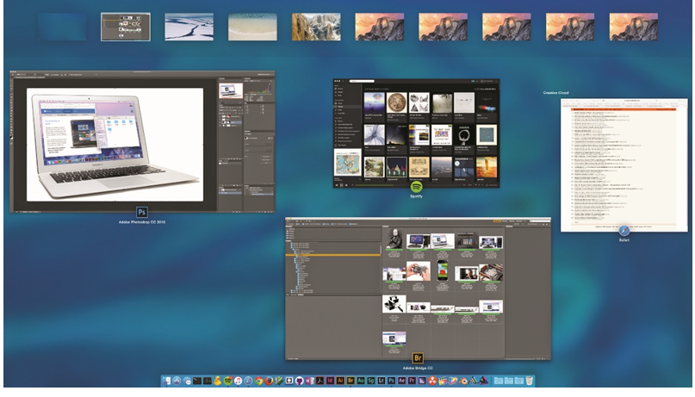
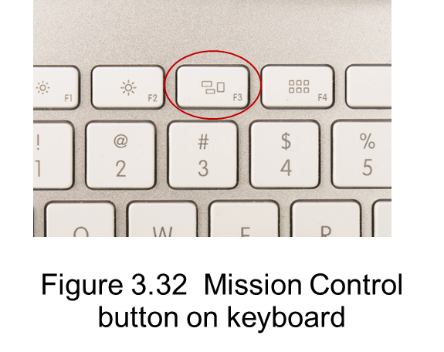
Operating System Characteristics
Desktop – background of main screen
Dock – frequently used applications as icons
Mission Control button
Brings up Mission Control
utility that allows you to
switch between open
applications and more
Supports Spaces – multiple
Desktops

Slide 27
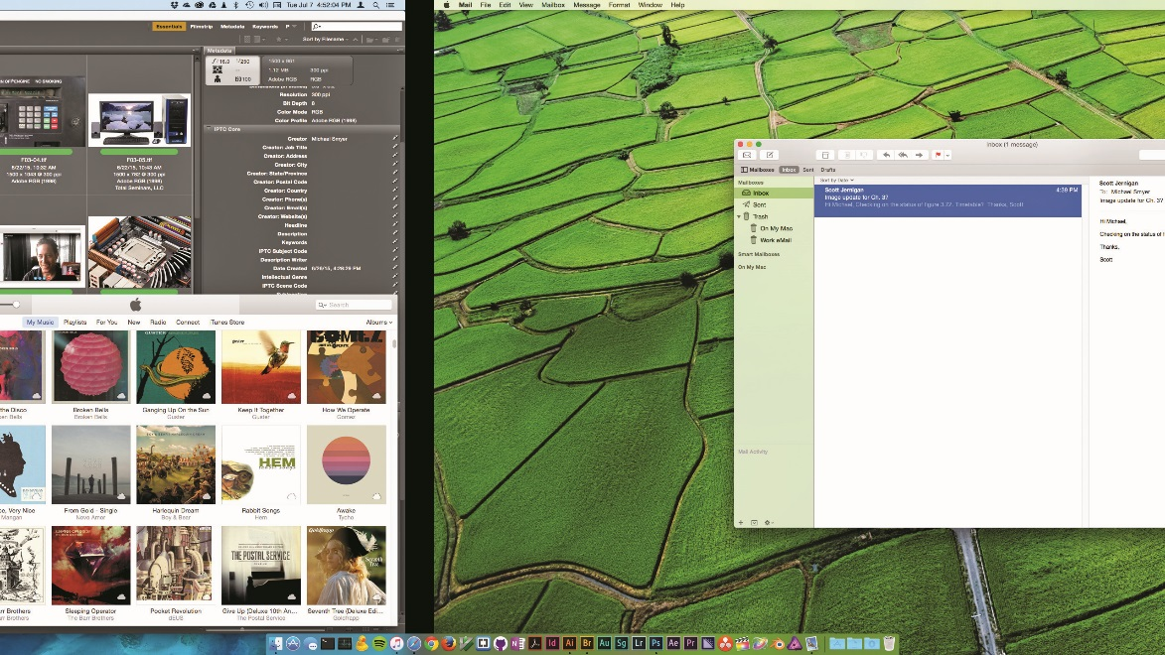
Operating System Characteristics
Linux hosts a variety of user interfaces called desktop environments (DEs)
Figure 3.34 Multiple Desktops

Slide 28
Operating System Characteristics

Slide 29
File Structures and Paths
Tree pattern
Root: drive or disc followed by folder, subfolder, etc.
Drives (roots) and discs have a drive letter designation.

Slide 30
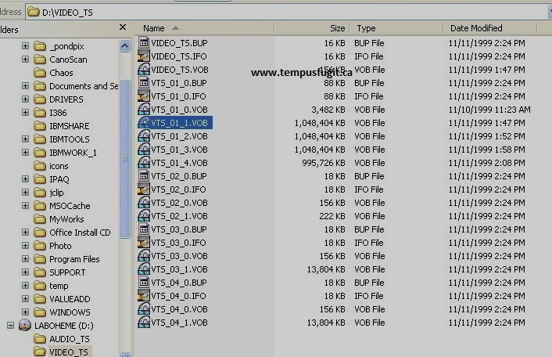
File Structures and Paths
Windows
Root directory – where the OS is installed
Access folders through Windows Explorer (Vista/7) and File Explorer (8/8.1/10)
File extension – appears
after file name
File association – tells OS
which application to use
with the file (registry)
Notes:
The CompTIA A+ 902 exam uses slightly older terms to describe the View options, such as view hidden files and hide file extensions. Microsoft changes the wording and placement of things in the View options from version to version. The functions stay the same: show or hide specific elements in a folder.
You can also right-click a file or folder, select Properties, and, on the General tab, change several aspects of the file or folder. You can make it hidden, for example, or read-only. Context menus unlock many options in Windows features.

Slide 31
File Structures and Paths
Windows
C:\Program Files (All Windows versions)
Default location for installing programs
Program files installed on 64-bit editions of Windows
C:\Program Files for 64-bit applications
C:\Program Files (x86) for 32-bit applications

Slide 32
File Structures and Paths
Windows
Personal documents in subfolders of C:\Users
C:\Users\Mike\Desktop
C:\Users\Mike\Documents
C:\Users\Mike\Downloads
C:\Users\Mike\Music
C:\Users\Mike\Pictures
C:\Users\Mike\Videos

Slide 33
File Structures and Paths
Mac OS X
Finder holds the key to files and folders.
The Mac style is different from Windows, but has functionally similar folders.
Linux
Pretty much the same structure for user organization
Home folder rather than Users folder

Slide 34
File Structures and Paths

Slide 35
The Tech Launch Points
Windows Vista/7
Control Panel
Maintenance, upgrade, and configuration
Exam assumes Classic view with large icons
Populated by applets – specific aspects of Windows
System Tools menu
Commonly accessed tools such as (System Information, Disk Defragmenter)
Command-line interface – text commands
Useful when graphical Windows does not work
Notes:
Add or adjust green line!!!!!!!!!!!!!!!!!

Slide 36
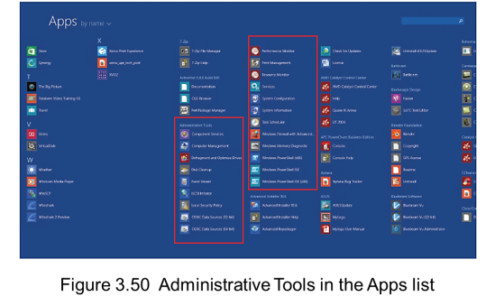
The Tech Launch Points
Windows 8/8.1
Control Panel
As with previous Windows versions—the go-to source for tech tools
Administrative Tools
Set up hard drives, manage devices, test system performance, etc…
Command Line
Next Slide

Slide 37
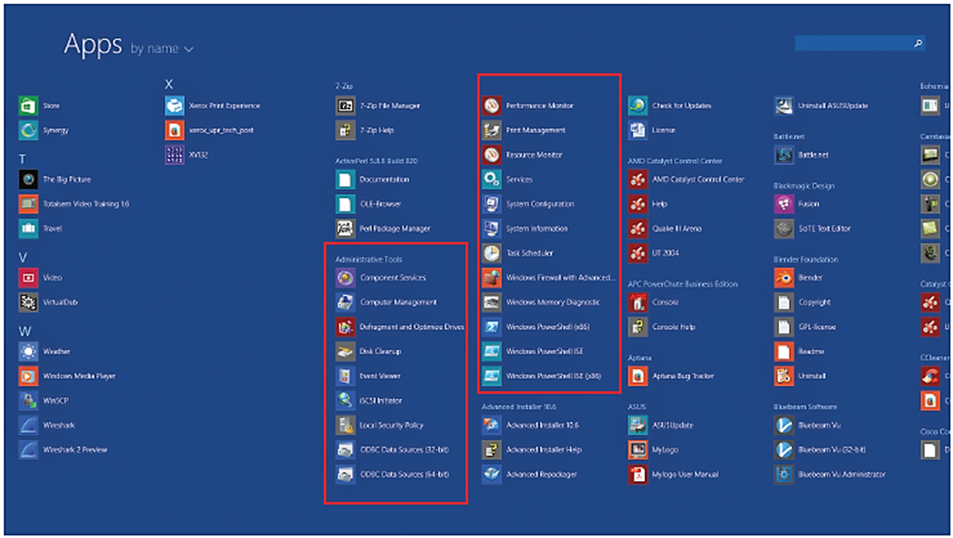
The Tech Launch Points

Slide 38
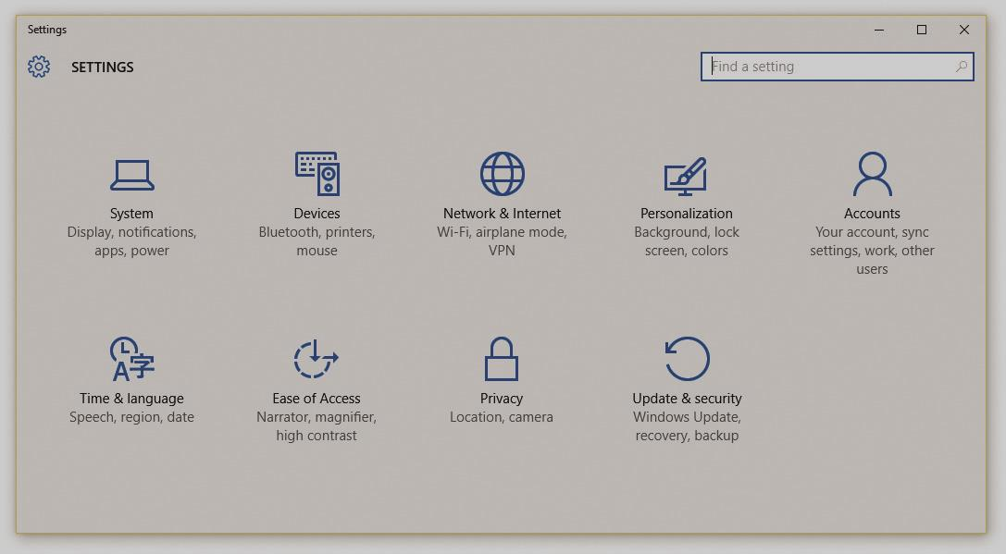
The Tech Launch Points
Windows 10 Control Panel
Settings App
Collection of utilities, apps, and tools in one handy place
Figure 3.52 Windows Settings app

Slide 39
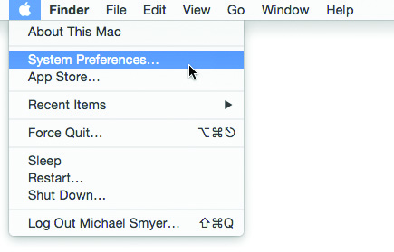
The Tech Launch Points
Mac OS X
System Preferences
Access to almost all administrative settings
Utilities folder
Located in the Applications folder
Figure 3.54 Accessing System Preferences

Slide 40
The Tech Launch Points
Linux
Terminal – command line
Unity (default for Ubuntu desktop)
System Settings
Gnome 3 (default for Fedora Workstation, Red Hat Enterprise Linux)
All Settings application
KDE Plasma Desktop (default for OpenSUSE, Kubuntu)
Kickoff menu – looks and works like Windows 7 Start menu

Slide 41

The Tech Launch Points

Slide 42
Summary
The computing process
Computing hardware
Computing software
Operating system characteristics
File structures and paths
Tech launch points

Slide 43


